Slide 1
Data Mining:
Principles and Algorithms
Mining Data Streams
Jiawei Han
Department of Computer Science
University of Illinois at Urbana-Champaign
www.cs.uiuc.edu/~hanj
©2014 Jiawei Han. All rights reserved.

Slide 2


Slide 3
Mining Data Streams
What is stream data? Why Stream Data Systems?
Stream data management systems: Issues and solutions
Stream data cube and multidimensional OLAP analysis
Stream frequent pattern analysis
Stream classification
Stream cluster analysis
Research issues

Slide 4
Characteristics of Data Streams
Data Streams
  Data streams—continuous, ordered, changing, fast, huge amount
  Traditional DBMS—data stored in finite, persistent data sets
Characteristics
  Huge volumes of continuous data, possibly infinite
  Fast changing and requires fast, real-time response
  Data stream captures nicely our data processing needs of today
  Random access is expensive—single scan algorithm (can only have one look)
  Store only the summary of the data seen thus far
  Most stream data are at pretty low-level or multi-dimensional in nature, needs multi-level and multi-dimensional processing

Slide 5
Stream Data Applications
Telecommunication calling records
Business: credit card transaction flows
Network monitoring and traffic engineering
Financial market: stock exchange
Engineering & industrial processes: power supply & manufacturing
Sensor, monitoring & surveillance: video streams, RFIDs
Security monitoring
Web logs and Web page click streams
Massive data sets (even saved but random access is too expensive)

Slide 6
DBMS versus DSMS
Persistent relations
One-time queries
Random access
“Unbounded” disk store
Only current state matters
No real-time services
Relatively low update rate
Data at any granularity
Assume precise data
Access plan determined by query processor, physical DB design
Transient streams
Continuous queries
Sequential access
Bounded main memory
Historical data is important
Real-time requirements
Possibly multi-GB arrival rate
Data at fine granularity
Data stale/imprecise
Unpredictable/variable data arrival and characteristics
Ack. From Motwani’s PODS tutorial slides

Slide 7
Mining Data Streams
What is stream data? Why Stream Data Systems?
Stream data management systems: Issues and solutions
Stream data cube and multidimensional OLAP analysis
Stream frequent pattern analysis
Stream classification
Stream cluster analysis
Research issues

Slide 8
Architecture: Stream Query Processing
SDMS (Stream Data Management System)
User/Application
Continuous Query
Results
Multiple streams
Stream Query
Processor
Scratch Space
(Main memory and/or Disk)

Slide 9
Challenges of Stream Data Processing
Multiple, continuous, rapid, time-varying, ordered streams
Main memory computations
Queries are often continuous
  Evaluated continuously as stream data arrives
  Answer updated over time
Queries are often complex
  Beyond element-at-a-time processing
  Beyond stream-at-a-time processing
  Beyond relational queries (scientific, data mining, OLAP)
Multi-level/multi-dimensional processing and data mining
  Most stream data are at low-level or multi-dimensional in nature

Slide 10
Processing Stream Queries
Query types
  One-time query vs. continuous query (being evaluated continuously as stream continues to arrive)
  Predefined query vs. ad-hoc query (issued on-line)
Unbounded memory requirements
  For real-time response, main memory algorithm should be used
  Memory requirement is unbounded if one will join future tuples
Approximate query answering
  With bounded memory, it is not always possible to produce exact answers
  High-quality approximate answers are desired
  Data reduction and synopsis construction methods
    Sketches, random sampling, histograms, wavelets, etc.

Slide 11
Methodologies for Stream Data Processing
Major challenges
  Keep track of a large universe, e.g., pairs of IP address, not ages
Methodology
  Synopses (trade-off between accuracy and storage): A summary given in brief terms that covers the major points of a subject matter
  Use synopsis data structure, much smaller (O(log^{k} N) space) than their base data set (O(N) space)
  Compute an approximate answer within a small error range (factor ε of the actual answer)
Major methods
  Random sampling
  Histograms
  Sliding windows
  Multi-resolution model
  Sketches
  Radomized algorithms

Slide 12
Stream Data Processing Methods (1)
Random sampling (but without knowing the total length in advance)
  Reservoir sampling: maintains a set of s candidates in the reservoir, which form a true random sample of the element seen so far in the stream. As the data stream flow, every new element has a certain probability (s/N) of replacing an old element in the reservoir.
Sliding windows
  Make decisions based only on recent data of sliding window size w
  An element arriving at time t expires at time t + w
Histograms
  Approximate the frequency distribution of element values in a stream
  Partition data into a set of contiguous buckets
  Equal-width (equal value range for buckets) vs. V-optimal (minimizing frequency variance within each bucket)
Multi-resolution models
  Popular models: balanced binary trees, micro-clusters, and wavelets

Slide 13
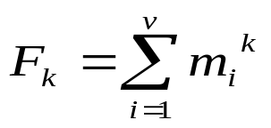
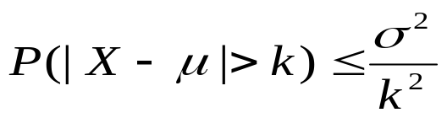

Stream Data Processing Methods (2)
Sketches
  Histograms and wavelets require multi-passes over the data but sketches can operate in a single pass
  Frequency moments of a stream A = {a₁, …, a_{N}}, F_{k}:
      where v: the universe or domain size, m_{i:} the frequency of i in the sequence
    Given N elements and v values, sketches can approximate F₀, F₁, F₂ in O(log v + log N) space
Randomized algorithms
  Monte Carlo algorithm: bound on running time but may not return correct result
  Chebyshev’s inequality:
    Let X be a random variable with mean μ and standard deviation σ
  Chernoff bound:
    Let X be the sum of independent Poisson trials X₁, …, X_{n}, δ in (0, 1]
    The probability decreases exponentially as we move from the mean

Slide 14
Approximate Query Answering in Streams
Sliding windows
  Only over sliding windows of recent stream data
  Approximation but often more desirable in applications
Batched processing, sampling and synopses
  Batched if update is fast but computing is slow
    Compute periodically, not very timely
  Sampling if update is slow but computing is fast
    Compute using sample data, but not good for joins, etc.
  Synopsis data structures
    Maintain a small synopsis or sketch of data
    Good for querying historical data
Blocking operators, e.g., sorting, avg, min, etc.
  Blocking if unable to produce the first output until seeing the entire input

Slide 15
Projects on DSMS (Data Stream Management System)
Research projects and system prototypes
  STREAM (Stanford): A general-purpose DSMS
  Cougar (Cornell): sensors
  Aurora (Brown/MIT): sensor monitoring, dataflow
  Hancock (AT&T): telecom streams
  Niagara (OGI/Wisconsin): Internet XML databases
  OpenCQ (Georgia Tech): triggers, incr. view maintenance
  Tapestry (Xerox): pub/sub content-based filtering
  Telegraph (Berkeley): adaptive engine for sensors
  Tradebot (www.tradebot.com): stock tickers & streams
  Tribeca (Bellcore): network monitoring
  MAIDS (UIUC/NCSA): Mining Alarming Incidents in Data Streams

Slide 16
Stream Data Mining vs. Stream Querying
Stream mining—A more challenging task in many cases
  It shares most of the difficulties with stream querying
    But often requires less “precision”, e.g., no join, grouping, sorting
  Patterns are hidden and more general than querying
  It may require exploratory analysis
    Not necessarily continuous queries
Stream data mining tasks
  Multi-dimensional on-line analysis of streams
  Mining outliers and unusual patterns in stream data
  Clustering data streams
  Classification of stream data

Slide 17
Mining Data Streams
What is stream data? Why Stream Data Systems?
Stream data management systems: Issues and solutions
Stream data cube and multidimensional OLAP analysis
Stream frequent pattern analysis
Stream classification
Stream cluster analysis
Research issues

Slide 18
Challenges for Mining Dynamics in Data Streams
Most stream data are at pretty low-level or multi-dimensional in nature: needs ML/MD processing
Analysis requirements
  Multi-dimensional trends and unusual patterns
  Capturing important changes at multi-dimensions/levels
  Fast, real-time detection and response
  Comparing with data cube: Similarity and differences
Stream (data) cube or stream OLAP: Is this feasible?
  Can we implement it efficiently?

Slide 19
Multi-Dimensional Stream Analysis: Examples
Analysis of Web click streams
  Raw data at low levels: seconds, web page addresses, user IP addresses, …
  Analysts want: changes, trends, unusual patterns, at reasonable levels of details
  E.g., Average clicking traffic in North America on sports in the last 15 minutes is 40% higher than that in the last 24 hours.”
Analysis of power consumption streams
  Raw data: power consumption flow for every household, every minute
  Patterns one may find: average hourly power consumption surges up 30% for manufacturing companies in Chicago in the last 2 hours today than that of the same day a week ago

Slide 20
A Stream Cube Architecture
A tilted time frame
  Different time granularities
    second, minute, quarter, hour, day, week, …
Critical layers
  Minimum interest layer (m-layer)
  Observation layer (o-layer)
  User: watches at o-layer and occasionally needs to drill-down down to m-layer
Partial materialization of stream cubes
  Full materialization: too space and time consuming
  No materialization: slow response at query time
  Partial materialization: what do we mean “partial”?

Slide 21
Cube: A Lattice of Cuboids
all
0-D(apex) cuboid
time
item
location
supplier
1-D cuboids
time,location
item,location
location,supplier
time,item
2-D cuboids
time,supplier
item,supplier
time,location,supplier
3-D cuboids
time,item,location
time,item,supplier
item,location,supplier
4-D(base) cuboid
time, item, location, supplier

Slide 22
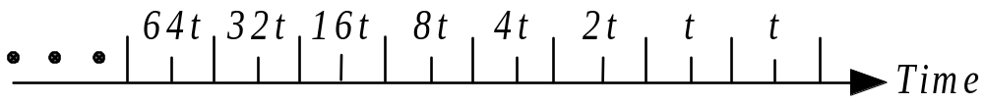
Time Dimension: A Titled Time Model
Natural tilted time frame:
  Example: Minimal: 15min, then 4 * 15mins → 1 hour, 24 hours → day, …
Logarithmic tilted time frame:
  Example: Minimal: 1 minute, then 1, 2, 4, 8, 16, 32, …

Slide 23
A Titled Time Model (2)
Pyramidal tilted time frame:
  Example: Suppose there are 5 frames and each takes maximal 3 snapshots
  Given a snapshot number N, if N mod 2^{d} = 0, insert into the frame number d. If there are more than 3 snapshots, “kick out” the oldest one.
Frame no. | Snapshots (by clock time)
0 | 69 67 65
1 | 70 66 62
2 | 68 60 52
3 | 56 40 24
4 | 48 16
5 | 64 32

Slide 24
Two Critical Layers in the Stream Cube
(*, theme, quarter)
o-layer (observation)
(user-group, URL-group, minute)
m-layer (minimal interest)
(individual-user, URL, second)
(primitive) stream data layer

Slide 25
OLAP Operation and Cube Materialization
OLAP( Online Analytical Processing) operations:
  Roll up (drill-up): summarize data
    by climbing up hierarchy or by dimension reduction
  Drill down (roll down): reverse of roll-up
    from higher level summary to lower level summary or detailed data, or introducing new dimensions
  Slice and dice: project and select
  Pivot (rotate): reorient the cube, visualization, 3D to series of 2D planes
Cube partial materialization
  Store some pre-computed cuboids for fast online processing

Slide 26
On-Line Partial Materialization vs. OLAP Processing
On-line materialization
  Materialization takes precious space and time
    Only incremental materialization (with tilted time frame)
  Only materialize “cuboids” of the critical layers?
    Online computation may take too much time
  Preferred solution:
    popular-path approach: Materializing those along the popular drilling paths
    H-tree structure: Such cuboids can be computed and stored efficiently using the H-tree structure
Online aggregation vs. query-based computation
  Online computing while streaming: aggregating stream cubes
  Query-based computation: using computed cuboids

Slide 27
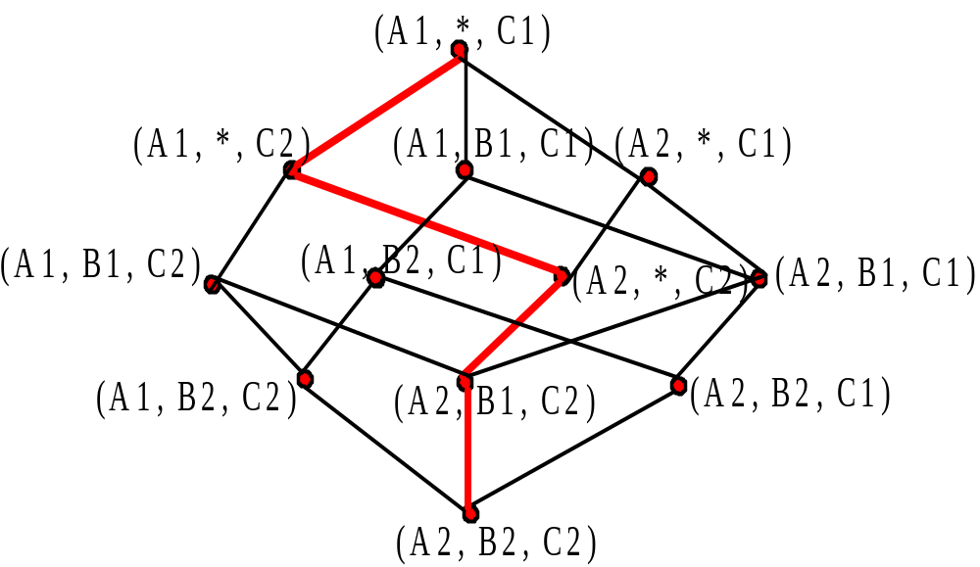
Stream Cube Structure: From m-layer to o-layer

Slide 28
An H-Tree Cubing Structure
root
Observation layer
Chicago
Urbana
Springfield
.com
.edu
.com
.gov
Minimal int. layer
Elec
Bio
Elec
Chem
6:00AM-7:00AM 156
7:00AM-8:00AM 201
8:00AM-9:00AM 235
……

Slide 29
Benefits of H-Tree and H-Cubing
H-tree and H-cubing
  Developed for computing data cubes and ice-berg cubes
    J. Han, J. Pei, G. Dong, and K. Wang, “Efficient Computation of Iceberg Cubes with Complex Measures”, SIGMOD'01
  Fast cubing, space preserving in cube computation
Using H-tree for stream cubing
  Space preserving
    Intermediate aggregates can be computed incrementally and saved in tree nodes
  Facilitate computing other cells and multi-dimensional analysis
  H-tree with computed cells can be viewed as stream cube

Slide 30
Mining Data Streams
What is stream data? Why Stream Data Systems?
Stream data management systems: Issues and solutions
Stream data cube and multidimensional OLAP analysis
Stream frequent pattern analysis
Stream classification
Stream cluster analysis
Research issues

Slide 31
What Is Frequent Pattern Analysis?
Frequent pattern: A pattern (a set of items, subsequences, substructures, etc.) that occurs frequently in a data set
First proposed by Agrawal, Imielinski, and Swami [AIS93] in the context of frequent itemsets and association rule mining
Motivation: Finding inherent regularities in data
  What products were often purchased together?— Beer and diapers?!
  What are the subsequent purchases after buying a PC?
  What kinds of DNA are sensitive to this new drug?
  Can we automatically classify web documents?
Applications
  Basket data analysis, cross-marketing, catalog design, sale campaign analysis, Web log (click stream) analysis, and DNA sequence analysis.

Slide 32
Frequent Patterns for Stream Data
Frequent pattern mining is valuable in stream applications
  e.g., network intrusion mining (Dokas et al., ’02)
Mining precise freq. patterns in stream data: unrealistic
  Even store them in a compressed form, such as FPtree
How to mine frequent patterns with good approximation?
  Approximate frequent patterns (Manku & Motwani, VLDB’02)
  Keep only current frequent patterns? No changes can be detected
Mining evolution freq. patterns (C. Giannella, J. Han, X. Yan, P.S. Yu, 2003)
  Use tilted time window frame
  Mining evolution and dramatic changes of frequent patterns
Space-saving computation of frequent and top-k elements (Metwally, Agrawal, and El Abbadi, ICDT'05)

Slide 33
Mining Approximate Frequent Patterns
Mining precise freq. patterns in stream data: unrealistic
  Even store them in a compressed form, such as FPtree
Approximate answers are often sufficient (e.g., trend/pattern analysis)
  Example: A router is interested in all flows:
    whose frequency is at least 1% (σ) of the entire traffic stream seen so far
    and feels that 1/10 of σ (ε = 0.1%) error is comfortable
How to mine frequent patterns with good approximation?
  Lossy Counting Algorithm (Manku & Motwani, VLDB’02)
    Major ideas: not tracing items until it becomes frequent
    Adv: guaranteed error bound
    Disadv: keep a large set of traces

Slide 34
Lossy Counting for Frequent Single Items
Bucket 1
Bucket 2
Bucket 3
Divide stream into ‘buckets’ (bucket size is 1/ ε = 1000)

Slide 35
First Bucket of Stream
Empty
(summary)
+
At bucket boundary, decrease all counters by 1

Slide 36
Next Bucket of Stream
+
At bucket boundary, decrease all counters by 1

Slide 37
Approximation Guarantee
Given: (1) support threshold: σ, (2) error threshold: ε, and (3) stream length N
Output: items with frequency counts exceeding (σ – ε) N
How much do we undercount?
  If stream length seen so far = N and bucket-size = 1/ε
  then frequency count error ≤ #buckets
  = N/bucket-size = N/(1/ε) = εN
Approximation guarantee
  No false negatives
  False positives have true frequency count at least (σ–ε)N
  Frequency count underestimated by at most εN

Slide 38
Lossy Counting For Frequent Itemsets
Divide Stream into ‘Buckets’ as for frequent items
But fill as many buckets as possible in main memory one time
Bucket 1
Bucket 2
Bucket 3
If we put 3 buckets of data into main memory one time,
then decrease each frequency count by 3

Slide 39
Update of Summary Data Structure
2
4
3
2
4
3
1
+
2
10
9
1
2
1
2
1
0
summary data
3 bucket data
in memory
summary data
Itemset ( ) is deleted.
That’s why we choose a large number of buckets
– delete more

Slide 40
Pruning Itemsets – Apriori Rule
2
1
2
+
1
1
summary data
3 bucket data
in memory
If we find itemset ( ) is not frequent itemset,
then we needn’t consider its superset

Slide 41
Summary of Lossy Counting
Strength
  A simple idea
  Can be extended to frequent itemsets
Weakness:
  Space bound is not good
  For frequent itemsets, they do scan each record many times
  The output is based on all previous data. But sometimes, we are only interested in recent data
A space-saving method for stream frequent item mining
  Metwally, Agrawal, and El Abbadi, ICDT'05

Slide 42
Mining Evolution of Frequent Patterns for Stream Data
Approximate frequent patterns (Manku & Motwani VLDB’02)
  Keep only current frequent patterns—No changes can be detected
Mining evolution and dramatic changes of frequent patterns (Giannella, Han, Yan, Yu, 2003)
  Use tilted time window frame
  Use compressed form to store significant (approximate) frequent patterns and their time-dependent traces
Note: To mine precise counts, one has to trace/keep a fixed (and small) set of items

Slide 43
Mining Data Streams
What is stream data? Why Stream Data Systems?
Stream data management systems: Issues and solutions
Stream data cube and multidimensional OLAP analysis
Stream frequent pattern analysis
Stream classification
Stream cluster analysis
Research issues

Slide 44
Classification Methods
Classification: Model construction based on training sets
Typical classification methods
  Decision tree induction
  Bayesian classification
  Rule-based classification
  Neural network approach
  Support Vector Machines (SVM)
  Associative classification
  K-Nearest neighbor approach
  Other methods
Are they all good for stream classification?

Slide 45
Classification for Dynamic Data Streams
Decision tree induction for stream data classification
  VFDT (Very Fast Decision Tree)/CVFDT (Domingos, Hulten, Spencer, KDD00/KDD01)
Is decision-tree good for modeling fast changing data, e.g., stock market analysis?
Other stream classification methods
  Instead of decision-trees, consider other models
    Naïve Bayesian
    Ensemble (Wang, Fan, Yu, Han. KDD’03)
    K-nearest neighbors (Aggarwal, Han, Wang, Yu. KDD’04)
    Classifying skewed stream data (Gao, Fan, and Han, SDM'07)
Evolution modeling: Tilted time framework, incremental updating, dynamic maintenance, and model construction
  Comparing of models to find changes

Slide 46
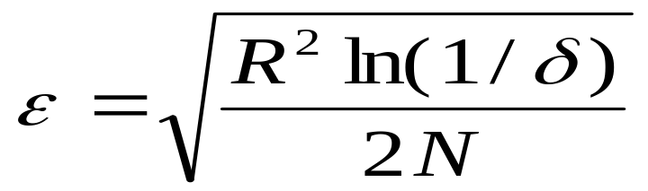
Build Very Fast Decision Trees Based on Hoeffding Inequality (Domingos, et al., KDD’00)
Hoeffding's inequality: A result in probability theory that gives an upper bound on the probability for the sum of random variables to deviate from its expected value
Based on Hoeffding Bound principle, classifying different samples leads to the same model with high probability —can use a small set of samples
Hoeffding Bound (Additive Chernoff Bound)
  Given: r: random variable, R: range of r, N: # independent observations
  True mean of r is at least r_{avg} – ε, with probability 1 – δ (where δ is user-specified)

Slide 47
Decision-Tree Induction with Data Streams
Packets > 10
Data Stream
yes
no
Protocol = http
Packets > 10
Data Stream
yes
no
Bytes > 60K
Protocol = http
yes
Protocol = ftp
Ack. From Gehrke’s SIGMOD tutorial slides

Slide 48
Hoeffding Tree: Strengths and Weaknesses
Strengths
  Scales better than traditional methods
    Sublinear with sampling
    Very small memory utilization
  Incremental
    Make class predictions in parallel
    New examples are added as they come
Weakness
  Could spend a lot of time with ties
  Memory used with tree expansion
  Number of candidate attributes

Slide 49
CVFDT (Concept-adapting VFDT)
Concept Drift
  Time-changing data streams
  Incorporate new and eliminate old
CVFDT
  Increments count with new example
  Decrement old example
    Sliding window
    Nodes assigned monotonically increasing IDs
  Grows alternate subtrees
  When alternate more accurate => replace old
  O(w) better runtime than VFDT-window

Slide 50
Ensemble of Classifiers Algorithm
H. Wang, W. Fan, P. S. Yu, and J. Han, “Mining Concept-Drifting Data Streams using Ensemble Classifiers”, KDD'03.
Method (derived from the ensemble idea in classification)
  train K classifiers from K chunks
  for each subsequent chunk
    train a new classifier
    test other classifiers against the chunk
    assign weight to each classifier
    select top K classifiers

Slide 51
Classifying Data Streams with Skewed Distribution
Stream Classification:
  Construct a classification model based on past records
  Use the model to predict labels for new data
  Help decision making
Concept drifts:
  Define and analyze concept drifts in data streams
  Show that expected error is not directly related to concept drifts
Classify data stream with skewed distribution (i.e., rare events)
  Employ both biased sampling and ensemble techniques
  Results indicate the proposed method reduces classification errors on the minority class

Slide 52
Concept Drifts
Changes in P(x, y) x-feature vector y-class label P(x,y) = P(y|x)P(x)
Four possibilities:
  No change: P(y|x), P(x) remain unchanged
  Feature change: only P(x) changes
  Conditional change: only P(y|x) changes
  Dual change: both P(y|x) and P(x) changes
Expected error:
No matter how concept changes, the expected error could increase, decrease, or remain unchanged
Training on the most recent data could help reduce expected error

Slide 53
Issues in stream classification
Descriptive model vs. generative model
  Generative models assume data follows some distribution while descriptive models make no assumptions
  Distribution of stream data is unknown and may evolve, so descriptive model is better
Label prediction vs. probability estimation
  Classify test examples into one class or estimate P(y|x) for each y
  Probability estimation is better:
    Stream applications may be stochastic (an example could be assigned to several classes with different probabilities)
    Probability estimates provide confidence information and could be used in post processing

Slide 54
Mining Skewed Data Stream
Skewed distribution
  Seen in many stream applications where positive examples are much less popular than the negative ones.
  Credit card fraud detection, network intrusion detection…
Existing stream classification methods
  Evaluate their methods on data with balanced class distribution
Problems of these methods on skewed data:
  Tend to ignore positive examples due to the small number
  The cost of misclassifying positive examples is usually huge, e.g., misclassifying credit card fraud as normal

Slide 55
Stream Ensemble Approach (1)
?
………
S₁
S₂
S_{m}
S_{m+1}
Classification Model
S_{m} as training data? Positive examples not sufficient!

Slide 56
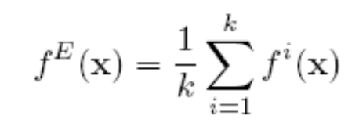
Stream Ensemble Approach (2)
Sampling
………
S₁
S₂
Ensemble
S_{m}
?
………
C₁
C₂
C_{k}

Slide 57
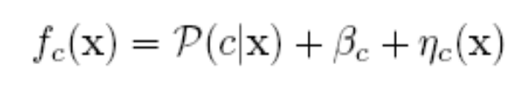





Analysis
Error Reduction:
  Sampling:
  Ensemble:
Efficiency Analysis:
  Single model:
  Ensemble:
  Ensemble is more efficient

Slide 58
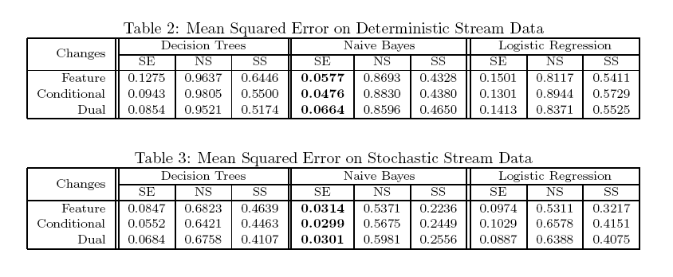
Experiments: Mean Squared Error on Synthetic Data
Test on concept-drift streams

Slide 59
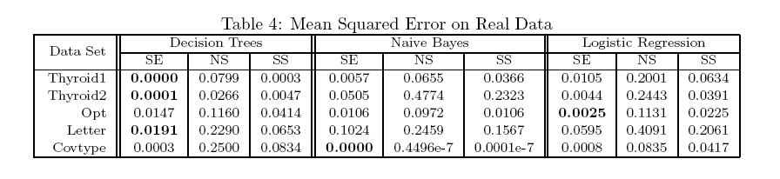
Experiments: Mean Squared Error on Real Data
Test on real data

Slide 60
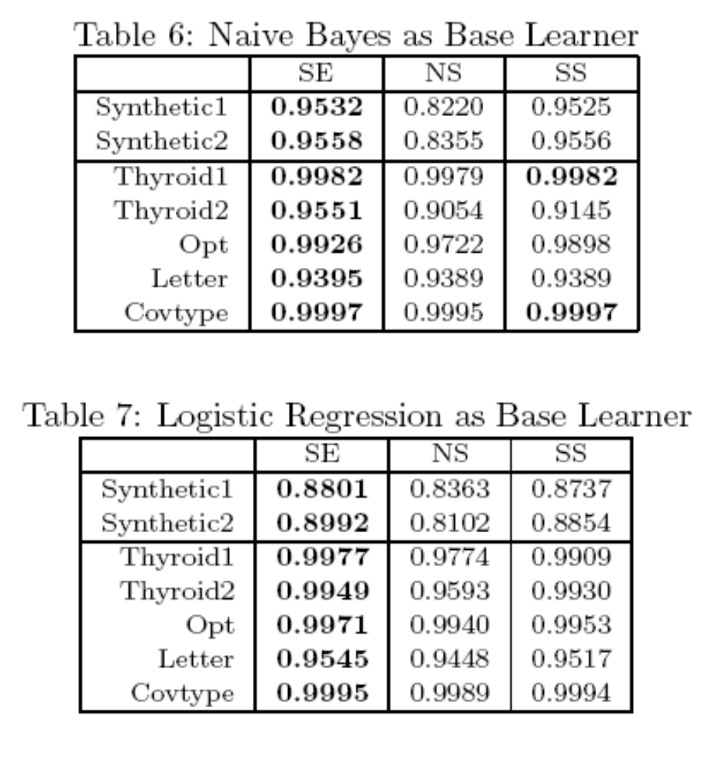
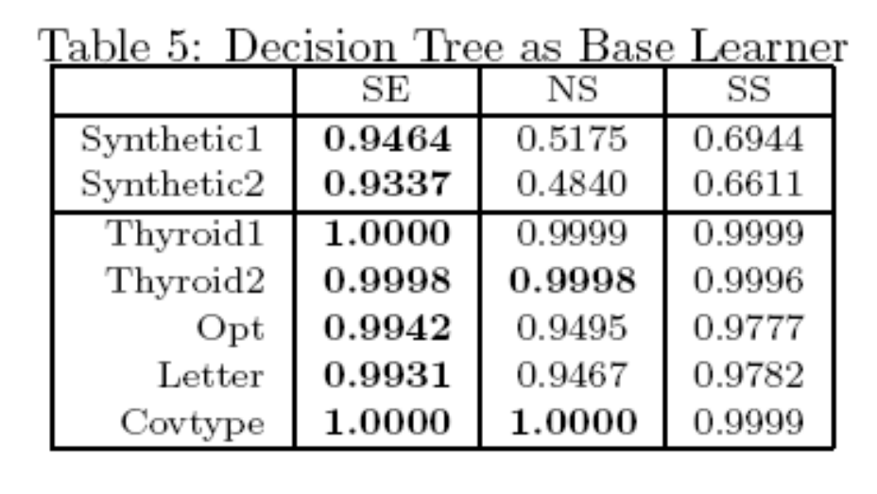
Experiments: Model Accuracy
Model accuracy

Slide 61
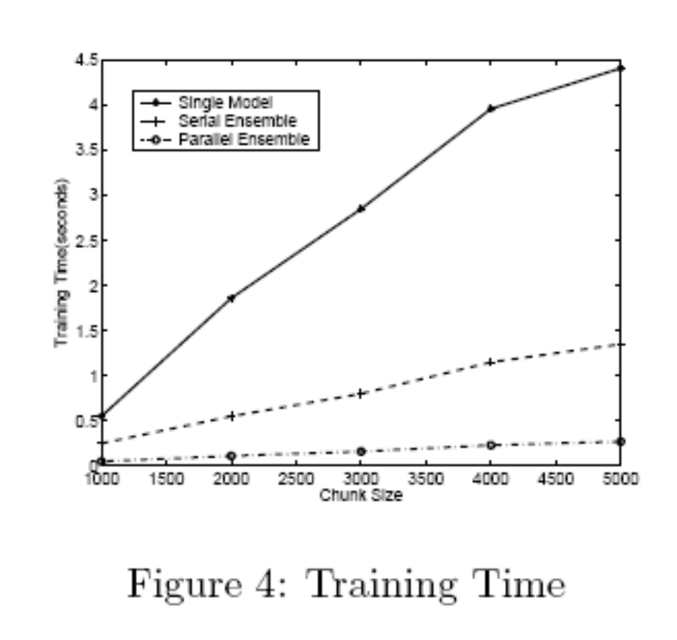
Experiments: Efficiency
Training time

Slide 62
Mining Data Streams
What is stream data? Why Stream Data Systems?
Stream data management systems: Issues and solutions
Stream data cube and multidimensional OLAP analysis
Stream frequent pattern analysis
Stream classification
Stream cluster analysis
Research issues

Slide 63
Cluster Analysis Methods
Cluster Analysis: Grouping similar objects into clusters
Types of data in cluster analysis
  Numerical, categorical, high-dimensional, …
Major Clustering Methods
  Partitioning Methods
  Hierarchical Methods
  Density-Based Methods
  Grid-Based Methods
  Model-Based Methods
  Clustering High-Dimensional Data
  Constraint-Based Clustering
Outlier Analysis: often a by-product of cluster analysis

Slide 64
Stream Clustering: A K-Median Approach
O'Callaghan et al., “Streaming-Data Algorithms for High-Quality Clustering”, (ICDE'02)
Base on the k-median method
  Data stream points from metric space
  Find k clusters in the stream s.t. the sum of distances from data points to their closest center is minimized
Constant factor approximation algorithm
  In small space, a simple two step algorithm:
  For each set of M records, S_{i}, find O(k) centers in S₁, …, S_{l}
    Local clustering: Assign each point in S_{i} to its closest center
  Let S’ be centers for S₁, …, S_{l} with each center weighted by number of points assigned to it
    Cluster S’ to find k centers

Slide 65
Hierarchical Clustering Tree
level-(i+1) medians
level-i medians
data points

Slide 66
Hierarchical Tree and Drawbacks
Method:
  maintain at most m level-i medians
  On seeing m of them, generate O(k) level-(i+1) medians of weight equal to the sum of the weights of the intermediate medians assigned to them
Drawbacks:
  Low quality for evolving data streams (register only k centers)
  Limited functionality in discovering and exploring clusters over different portions of the stream over time

Slide 67
Clustering for Mining Stream Dynamics
Network intrusion detection: one example
  Detect bursts of activities or abrupt changes in real time—by on-line clustering
Our methodology (C. Agarwal, J. Han, J. Wang, P.S. Yu, VLDB’03)
  Tilted time frame work: o.w. dynamic changes cannot be found
  Micro-clustering: better quality than k-means/k-median
    incremental, online processing and maintenance)
  Two stages: micro-clustering and macro-clustering
  With limited “overhead” to achieve high efficiency, scalability, quality of results and power of evolution/change detection

Slide 68
CluStream: A Framework for Clustering Evolving Data Streams
Design goal
  High quality for clustering evolving data streams with greater functionality
  While keep the stream mining requirement in mind
    One-pass over the original stream data
    Limited space usage and high efficiency
CluStream: A framework for clustering evolving data streams
  Divide the clustering process into online and offline components
    Online component: periodically stores summary statistics about the stream data
    Offline component: answers various user questions based on the stored summary statistics

Slide 69
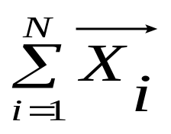
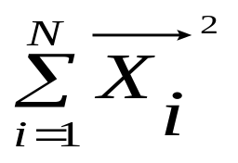
BIRCH: A Micro-Clustering Approach
Clustering Feature: CF = (N, LS, SS)
where N: # data points, LS = , SS =
Root
B = 7
L = 6
CF₁
CF₂
CF₃
CF₆
child₁
child₂
child₃
child₆
Non-leaf node
CF₁
CF₂
CF₃
CF₅
child₁
child₂
child₃
child₅
Leaf node
Leaf node
prev
CF₁
CF₂
CF₆
next
prev
CF₁
CF₂
CF₄
next

Slide 70




The CluStream Framework
Micro-cluster
  Statistical information about data locality
  Temporal extension of the cluster-feature vector
    Multi-dimensional points with time stamps
    Each point contains d dimensions, i.e.,
    A micro-cluster for n points is defined as a (2.d + 3) tuple
Pyramidal time frame
  Decide at what moments the snapshots of the statistical information are stored away on disk

Slide 71
CluStream: Pyramidal Time Frame
Pyramidal time frame
  Snapshots of a set of micro-clusters are stored following the pyramidal pattern
    They are stored at differing levels of granularity depending on the recency
  Snapshots are classified into different orders varying from 1 to log(T)
    The i-th order snapshots occur at intervals of α^{i} where α ≥ 1
    Only the last (α + 1) snapshots are stored

Slide 72
CluStream: Clustering On-line Streams
Online micro-cluster maintenance
  Initial creation of q micro-clusters
    q is usually significantly larger than the number of natural clusters
  Online incremental update of micro-clusters
    If new point is within max-boundary, insert into the micro-cluster
    o.w., create a new cluster
    May delete obsolete micro-cluster or merge two closest ones
Query-based macro-clustering
  Based on a user-specified time-horizon h and the number of macro-clusters k, compute macroclusters using the k-means algorithm

Slide 73
Mining Data Streams
What is stream data? Why SDS?
Stream data management systems: Issues and solutions
Stream data cube and multidimensional OLAP analysis
Stream frequent pattern analysis
Stream classification
Stream cluster analysis
Research issues

Slide 74
Stream Data Mining: Research Issues
Mining sequential patterns in data streams
Mining partial periodicity in data streams
Mining outliers and unusual patterns for botnet detection
Stream clustering
  Multi-dimensional clustering analysis
    Cluster not confined to 2-D metric space, how to incorporate other features, especially non-numerical properties
  Stream clustering with other clustering approaches
  Constraint-based cluster analysis with data streams
Real-time stream data mining in cyberphysical systems

Slide 75
Summary: Stream Data Mining
Stream data mining: A rich and on-going research field
  Current research focus in database community:
    DSMS system architecture, continuous query processing, supporting mechanisms
  Stream data mining and stream OLAP analysis
    Powerful tools for finding general and unusual patterns
    Effectiveness, efficiency and scalability: lots of open problems
Our philosophy on stream data analysis and mining
  A multi-dimensional stream analysis framework
  Time is a special dimension: Tilted time frame
  What to compute and what to save?—Critical layers
  Partial materialization and precomputation
  Mining dynamics of stream data

Slide 76
References on Stream Data Mining (1)
C. Aggarwal, J. Han, J. Wang, P. S. Yu, “A Framework for Clustering Data Streams”, VLDB'03
C. C. Aggarwal, J. Han, J. Wang and P. S. Yu, “On-Demand Classification of Evolving Data Streams”, KDD'04
C. Aggarwal, J. Han, J. Wang, and P. S. Yu, “A Framework for Projected Clustering of High Dimensional Data Streams”, VLDB'04
S. Babu and J. Widom, “Continuous Queries over Data Streams”, SIGMOD Record, Sept. 2001
B. Babcock, S. Babu, M. Datar, R. Motwani and J. Widom, “Models and Issues in Data Stream Systems”, PODS'02.
Y. Chen, G. Dong, J. Han, B. W. Wah, and J. Wang, “Multi-Dimensional Regression Analysis of Time-Series Data Streams”, VLDB'02
P. Domingos and G. Hulten, “Mining high-speed data streams”, KDD'00
A. Dobra, M. N. Garofalakis, J. Gehrke, and R. Rastogi, “Processing Complex Aggregate Queries over Data Streams”, SIGMOD’02
J. Gehrke, F. Korn, and D. Srivastava, “On computing correlated aggregates over continuous data streams”, SIGMOD'01
J. Gao, W. Fan, and J. Han, “A General Framework for Mining Concept-Drifting Data Streams with Skewed Distributions”, SDM'07.

Slide 77
References on Stream Data Mining (2)
S. Guha, N. Mishra, R. Motwani, and L. O'Callaghan, “Clustering Data Streams”, FOCS'00
G. Hulten, L. Spencer and P. Domingos, “Mining time-changing data streams”, KDD’01
S. Madden, M. Shah, J. Hellerstein, V. Raman, “Continuously Adaptive Continuous Queries over Streams”, SIGMOD’02
G. Manku, R. Motwani, “Approximate Frequency Counts over Data Streams”, VLDB’02
A. Metwally, D. Agrawal, and A. El Abbadi. “Efficient Computation of Frequent and Top-k Elements in Data Streams”. ICDT'05
S. Muthukrishnan, “Data streams: algorithms and applications”, Proc 2003 ACM-SIAM Symp. Discrete Algorithms, 2003
R. Motwani and P. Raghavan, Randomized Algorithms, Cambridge Univ. Press, 1995
S. Viglas and J. Naughton, “Rate-Based Query Optimization for Streaming Information Sources”, SIGMOD’02
Y. Zhu and D. Shasha. “StatStream: Statistical Monitoring of Thousands of Data Streams in Real Time”, VLDB’02
H. Wang, W. Fan, P. S. Yu, and J. Han, “Mining Concept-Drifting Data Streams using Ensemble Classifiers”, KDD'03

Slide 78
